Slide 1
Lecture 3: Divide and Conquer

Slide 2
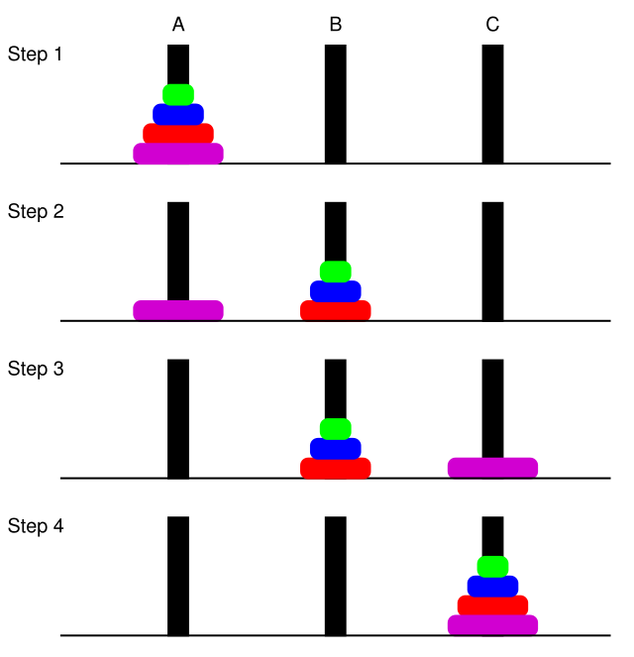

A quick review of recursion and recurrences
Classical example: Tower of Hanoi
Keys things to remember:
Reduce a problem to the same problem, but with a smaller size
The base case
MoveTower($n$, peg1, peg2, peg3):
if $n=1$ then
move the top disc from peg1 to peg3
return
else
MoveTower($n−1$, peg1, peg3, peg2)
move the top disc from peg1 to peg3
MoveTower($n−1$, peg2, peg1, peg3)

Slide 3
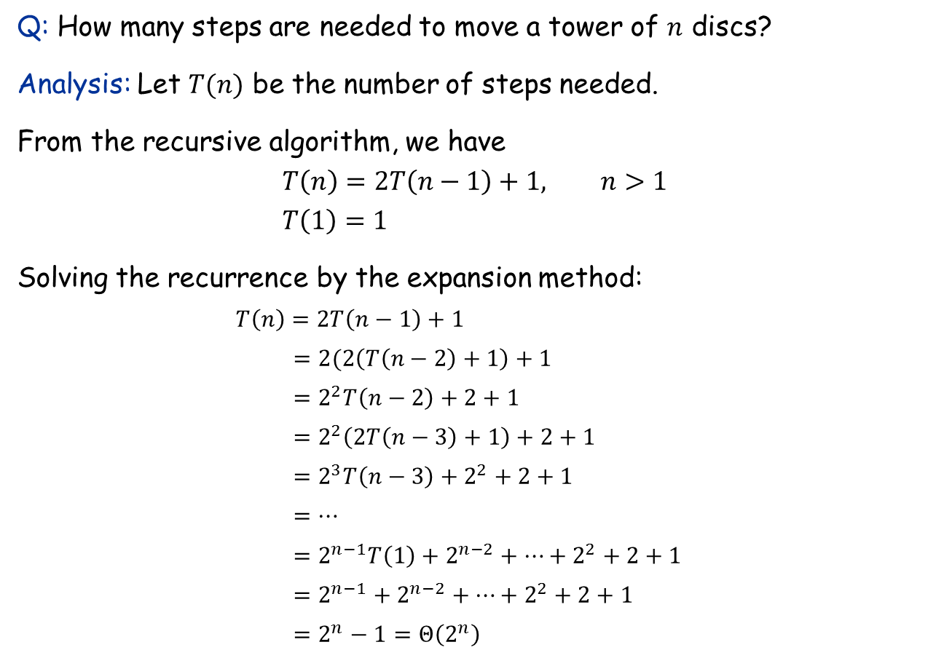
Analyzing a recursive algorithm with recurrence
Q: How many steps are needed to move a tower of $n$ discs?
Analysis: Let $T(n)$ be the number of steps needed.
From the recursive algorithm, we have
$$T\left(n\right)=2T\left(n−1\right)+1, n>1 \\ T\left(1\right)=1$$
Solving the recurrence by the expansion method:
$T\left(n\right)=2T\left(n−1\right)+1$ $=2(2\left(T\left(n−2\right)+1\right)+1$
$=2^{2}T\left(n−2\right)+2+1$
$=2^{2}\left(2T\left(n−3\right)+1\right)+2+1$
$=2^{3}T\left(n−3\right)+2^{2}+2+1$
$=…$
$=2^{n−1}T\left(1\right)+{2^{n−2}+…+2}^{2}+2+1$
$=2^{n−1}+{2^{n−2}+…+2}^{2}+2+1$
$=2^{n}−1=Θ\left(2^{n}\right)$

Slide 4















Solving recurrences with the recursion tree method
$$T\left(n\right)=2T\left(n−1\right)+1, n>1 \\ T\left(1\right)=1$$
$$T\left(n\right)$$
$$1$$
level $0: 1$ node
$$T\left(n−1\right)$$
$$1$$
$$T\left(n−1\right)$$
$$1$$
level $1: 2$ nodes
$$T\left(n−2\right)$$
$$T\left(n−2\right)$$
$$T\left(n−2\right)$$
$$T\left(n−2\right)$$
level $2: 2^{2}$ nodes
level $i: 2^{i}$ nodes
total number of nodes: $1+2+2^{2}+…2^{n−1}=2^{n}−1$
level $n−1: 2^{n−1}$ nodes
Note: This is actually equivalent to the expansion method, but clearer.

Slide 5
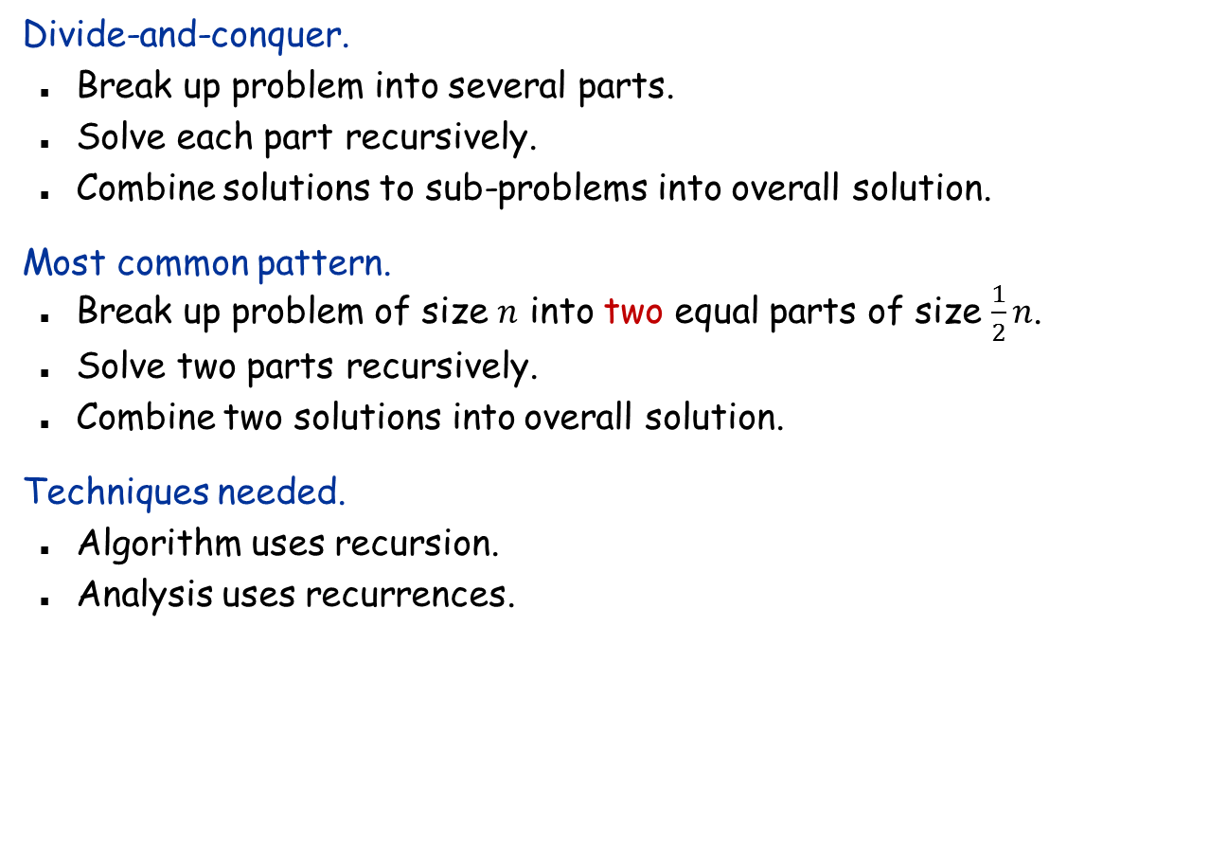
Divide-and-Conquer
Divide-and-conquer.
Break up problem into several parts.
Solve each part recursively.
Combine solutions to sub-problems into overall solution.
Most common pattern.
Break up problem of size $n$ into two equal parts of size $\frac{1}{2}n$.
Solve two parts recursively.
Combine two solutions into overall solution.
Techniques needed.
Algorithm uses recursion.
Analysis uses recurrences.

Slide 6

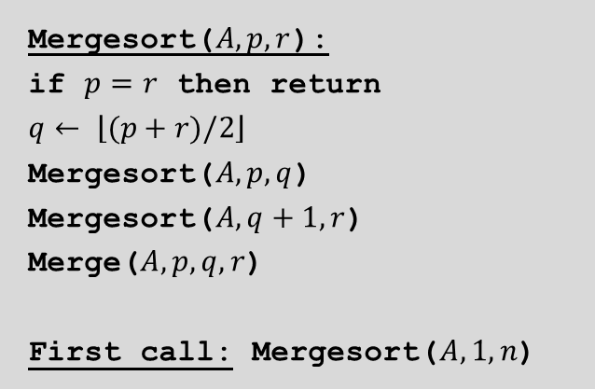


Merge sort
Merge sort.
Divide array into two halves.
Recursively sort each half.
Merge two halves to make sorted whole.
Mergesort($A, p, r$):
if $p=r$ then return
$$q← \left\lfloor (p+r)/2\right\rfloor$$
Mergesort($A, p,q$)
Mergesort($A, q+1, r$)
Merge($A, p,q,r$)
First call: Mergesort($A,1,n$)
A
L
G
O
R
I
T
H
M
S
A
L
G
O
R
I
T
H
M
S
divide
$$O(1)$$
A
G
L
O
R
H
I
M
S
T
sort
$$2T(n/2)$$
A
G
H
I
L
M
O
R
S
T
merge
$$O(n)$$

Slide 7
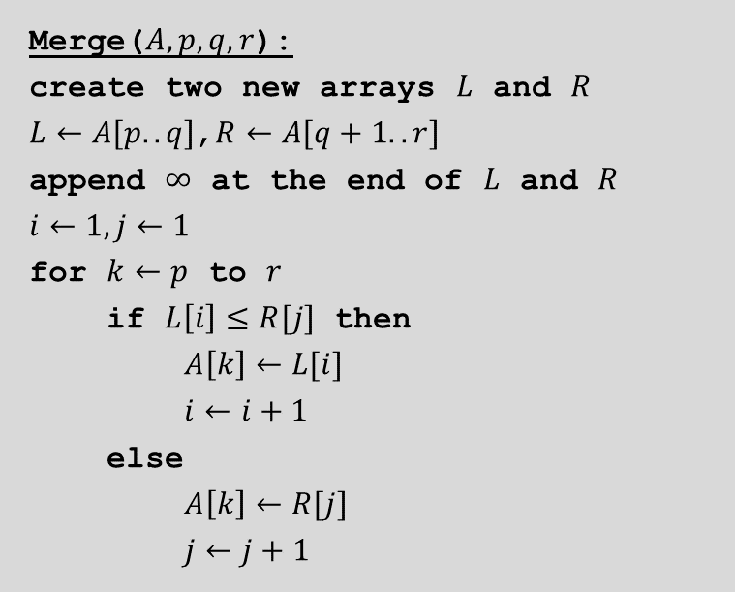
Merge
Merge. Combine two sorted lists into a sorted whole.
A
G
L
O
R
H
I
M
S
T
A
G
H
I
Merge($A, p,q,r$):
create two new arrays $L$ and $R$
$L←A[p..q]$,$R←A[q+1..r]$
append $∞$ at the end of $L$ and $R$
$$i←1,j←1$$
for $k←p$ to $r$
if $L\left[i\right]≤R[j]$ then
$A\left[k\right]←L[i]$
$i←i+1$
else
$A\left[k\right]←R[j]$
$j←j+1$

Slide 8
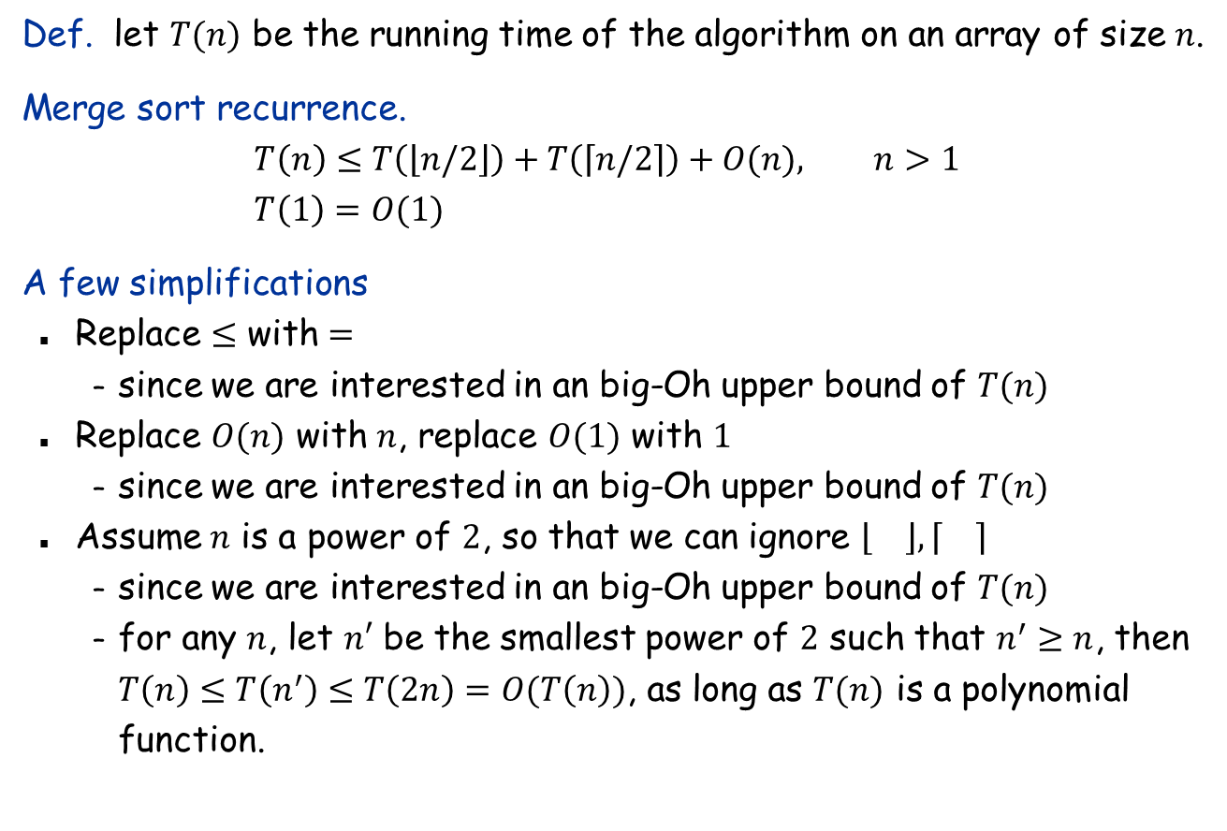
Analyzing merge sort
Def. let $T(n)$ be the running time of the algorithm on an array of size $n$.
Merge sort recurrence.
$$T\left(n\right)≤T\left(\left\lfloor n/2\right\rfloor \right)+T\left(\left\lceil n/2\right\rceil \right)+O(n), n>1 \\ T\left(1\right)=O(1)$$
A few simplifications
Replace $≤$ with $=$
since we are interested in an big-Oh upper bound of $T(n)$
Replace $O(n)$ with $n$, replace $O(1)$ with $1$
since we are interested in an big-Oh upper bound of $T(n)$
Assume $n$ is a power of $2$, so that we can ignore $\left\lfloor \right\rfloor ,\left\lceil \right\rceil$
since we are interested in an big-Oh upper bound of $T(n)$
for any $n$, let $n′$ be the smallest power of $2$ such that $n^{′}≥n$, then $T\left(n\right)≤T\left(n^{′}\right)≤T\left(2n\right)=O(T\left(n\right))$, as long as $T(n)$ is a polynomial function.

Slide 9




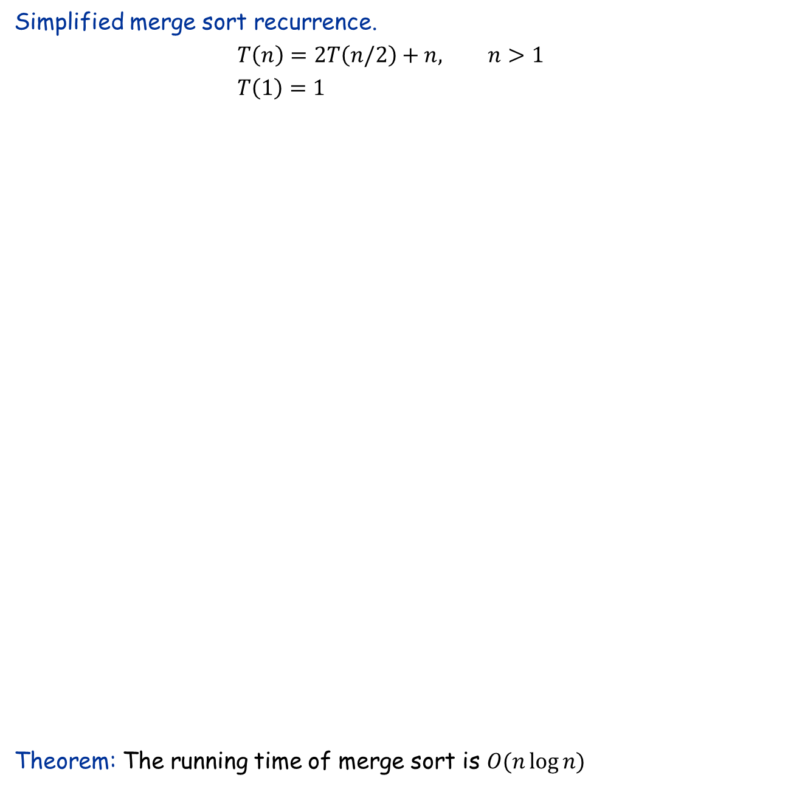



















Solve the recurrence
Simplified merge sort recurrence.
$$T\left(n\right)=2T\left(n/2\right)+n, n>1 \\ T\left(1\right)=1$$
Theorem: The running time of merge sort is $O(n\log{n)}$
$$T(n)$$
$$n$$
$$T(n/2)$$
$$T(n/2)$$
$$2⋅n/2$$
$$T(n/4)$$
$$T(n/4)$$
$$T(n/4)$$
$$T(n/4)$$
$$4⋅n/4$$
$$log2n$$
. . .
$$T(n/2k)$$
$$2k⋅n/2k$$
. . .
$$T(1)$$
$$T(1)$$
$T(1$)
$$T(1)$$
$$T(1)$$
$$T(1)$$
$$T(1)$$
$$T(1)$$
$$n⋅1$$
So, merge sort runs in $O(n\log{n)}$ time.
$$n log2n$$

Slide 10
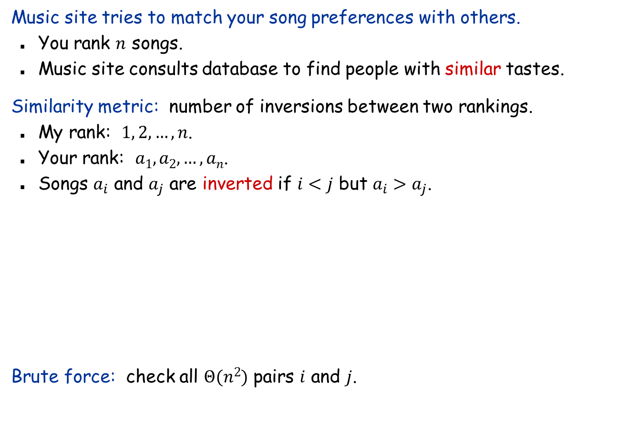
Problem: Counting Inversions
Music site tries to match your song preferences with others.
You rank $n$ songs.
Music site consults database to find people with similar tastes.
Similarity metric: number of inversions between two rankings.
My rank: $1, 2, …, n$.
Your rank: $a1, a2, …, an$.
Songs $a_{i}$ and $a_{j}$ are inverted if $i<j$ but $a_{i}>a_{j}$.
Brute force: check all $Θ(n2)$ pairs $i$ and $j$.
Songs
A
B
C
D
E
Inversions
3-2, 4-2
Me
1
2
3
4
5
You
1
3
4
2
5

Slide 11



Counting Inversions: Divide-and-Conquer
Divide-and-conquer.
Divide: divide array into two halves.
Conquer: recursively count inversions in each half.
Combine: count inversions where $ai$ and $aj$ are in different halves, and return sum of three quantities.
1
5
4
8
10
2
6
9
12
11
3
7
Divide: $O(1)$.
1
5
4
8
10
2
6
9
12
11
3
7
Conquer: $2T(n/2)$
5 blue-blue inversions
8 green-green inversions
9 blue-green inversions
5-3, 4-3, 8-6, 8-3, 8-7, 10-6, 10-9, 10-3, 10-7
Combine: ???
Total = 5 + 8 + 9 = 22.

Slide 12

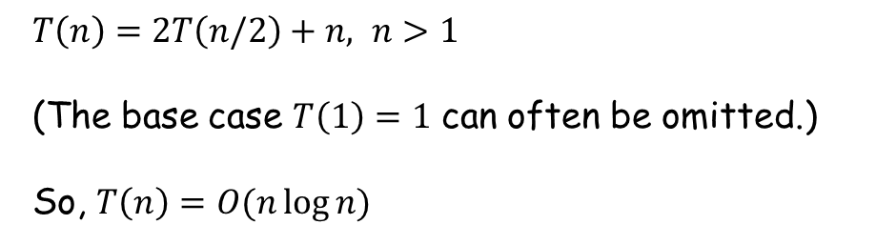
Counting Inversions: Combine
Combine: count blue-green inversions
Assume each half is sorted.
Count inversions where $ai$ and $aj$ are in different halves.
Merge two sorted halves into sorted whole to maintain the sortedness invariant.
3
7
10
14
18
19
2
11
16
17
23
25
6
3
2
2
0
0
13 blue-green inversions: 6 + 3 + 2 + 2 + 0 + 0
Count: O(n)
2
3
7
10
11
14
16
17
18
19
23
25
Merge: O(n)
$T\left(n\right)=2T\left(n/2\right)+n, n>1$
(The base case $T\left(1\right)=1$ can often be omitted.)
So, $T\left(n\right)=O(n\log{n)}$

Slide 13



Counting Inversions: Implementation
Pre-condition. [Merge-and-Count] $A[p..q]$ and $A[q+1,r]$ are sorted.
Post-condition. [Sort-and-Count] $A[p..q]$ is sorted.
Sort-and-Count($A, p, r$):
if $p=r$ then return
$$q← \left\lfloor (p+r)/2\right\rfloor$$
$c_{1}←$Sort-and-Count($A, p,q$)
$c_{2}←$Sort-and-Count($A, q+1, r$)
$c_{3}←$Merge-and-Count($A, p,q,r$)
return $c_{1}+c_{2}+c_{3}$
First call: Sort-and-Count($A,1,n$)
Merge-and-Count($A, p, q,r$):
create two new arrays $L$ and $R$
$L←A[p..q]$,$R←A[q+1..r]$
append $∞$ at the end of $L$ and $R$
$$i←1,j←1$$
$$c←0$$
for $k←p$ to $r$
if $L\left[i\right]≤R[j]$ then
$A\left[k\right]←L[i]$
$i←i+1$
else
$A\left[k\right]←R[j]$
$j←j+1$
$c←c+q−i+1$

Slide 14

Interesting facts about number of inversions
Fact: The number of inversions in an array is equal to the minimum number of adjacent swaps needed to sort the array.
Proof left as a head-banging exercise.
Example: {4, 2, 5, 3, 1}
Swap 3, 1: {4, 2, 5, 1, 3}
Swap 5, 1: {4, 2, 1, 5, 3}
Swap 4, 2: {2, 4, 1, 5, 3}
Swap 4, 1: {2, 1, 4, 5, 3}
Swap 2, 1: {1, 2, 4, 5, 3}
Swap 5, 3: {1, 2, 4, 3, 5}
Swap 3, 4: {1, 2, 3, 4, 5}
Fact: Bubble sort uses the minimum number of swaps.

Slide 15
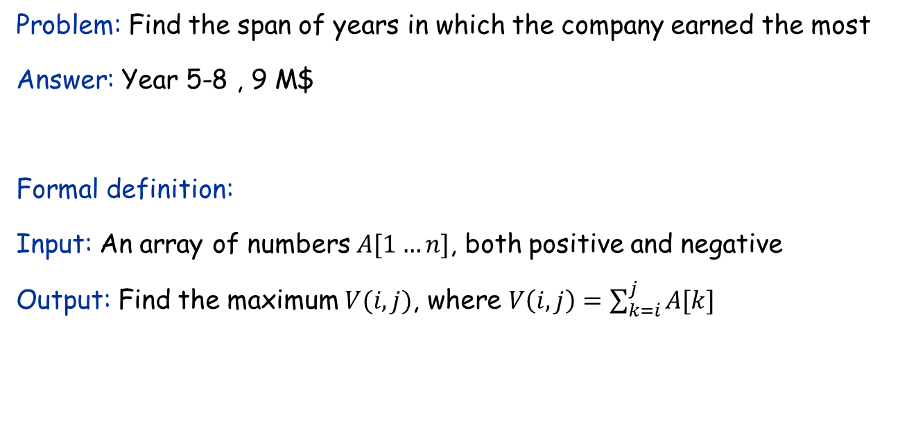
The Maximum Subarray Problem
Input: Profit history of a company of the years.
Year | 1 | 2 | 3 | 4 | 5 | 6 | 7 | 8 | 9
Profit (M$) | -3 | 2 | 1 | -4 | 5 | 2 | -1 | 3 | -1
Problem: Find the span of years in which the company earned the most
Answer: Year 5-8 , 9 M$
Formal definition:
Input: An array of numbers $A[1…n]$, both positive and negative
Output: Find the maximum $V(i,j)$, where $V\left(i,j\right)=\sum_{k=i}^{j}{A[k]}$

Slide 16


A brute-force algorithm
Idea: Calculate the value of $V(i,j)$ for each pair $i≤j$ and return the maximum value.
Running time: $O(n^{3})$
$$V_{max} ← A[1]$$
for $i←1$ to $n$ do
for $j←i$ to $n$ do
// calculate $V(i,j)$
$V←0$
for $k←i$ to $j$ do
$V←V+A[k]$
if $V>V_{max}$ then $V_{max}←V$
return $V_{max}$

Slide 17


A data-reuse algorithm
Idea:
Don’t need to calculate each $V(i,j)$ from scratch.
Exploit the fact: $V\left(i,j\right)=V\left(i,j−1\right)+A[j]$
Running time: $O(n^{2})$
$$V_{max} ← A[1]$$
for $i←1$ to $n$ do
$V←0$
for $j←i$ to $n$ do
// calculate $V(i,j)$
$V←V+A[j]$
if $V>V_{max}$ then $V_{max}←V$;
return $V_{max}$

Slide 18
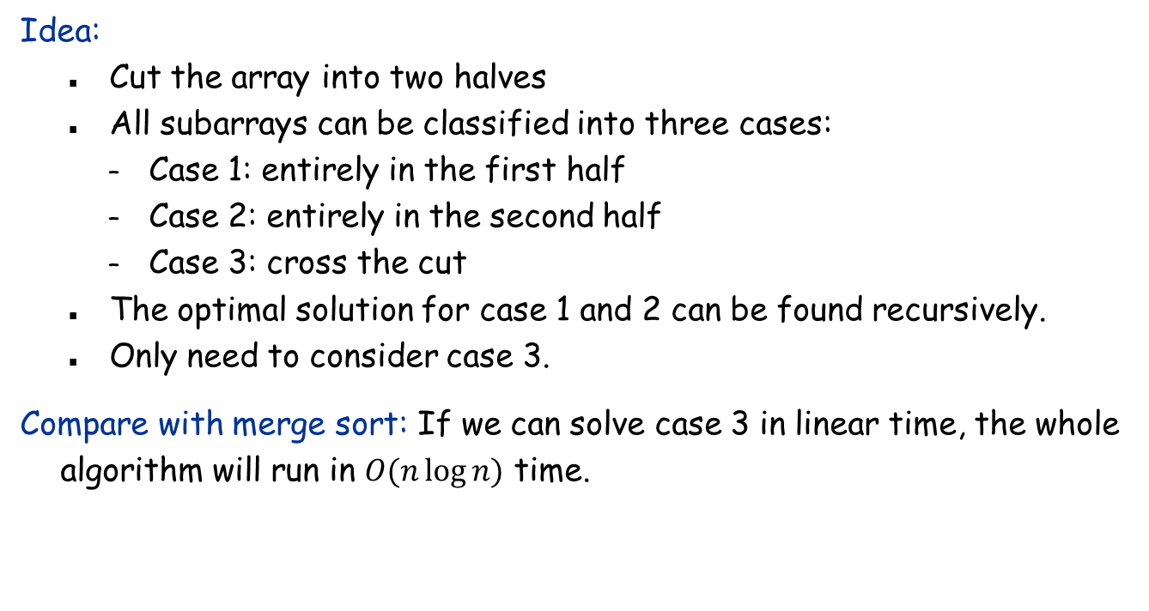
A divide-and-conquer algorithm
Year | 1 | 2 | 3 | 4 | 5 | 6 | 7 | 8 | 9
Profit (M$) | -3 | 2 | 1 | -4 | 5 | 2 | -1 | 3 | -1
Idea:
Cut the array into two halves
All subarrays can be classified into three cases:
Case 1: entirely in the first half
Case 2: entirely in the second half
Case 3: cross the cut
The optimal solution for case 1 and 2 can be found recursively.
Only need to consider case 3.
Compare with merge sort: If we can solve case 3 in linear time, the whole algorithm will run in $O(n\log{n)}$ time.

Slide 19
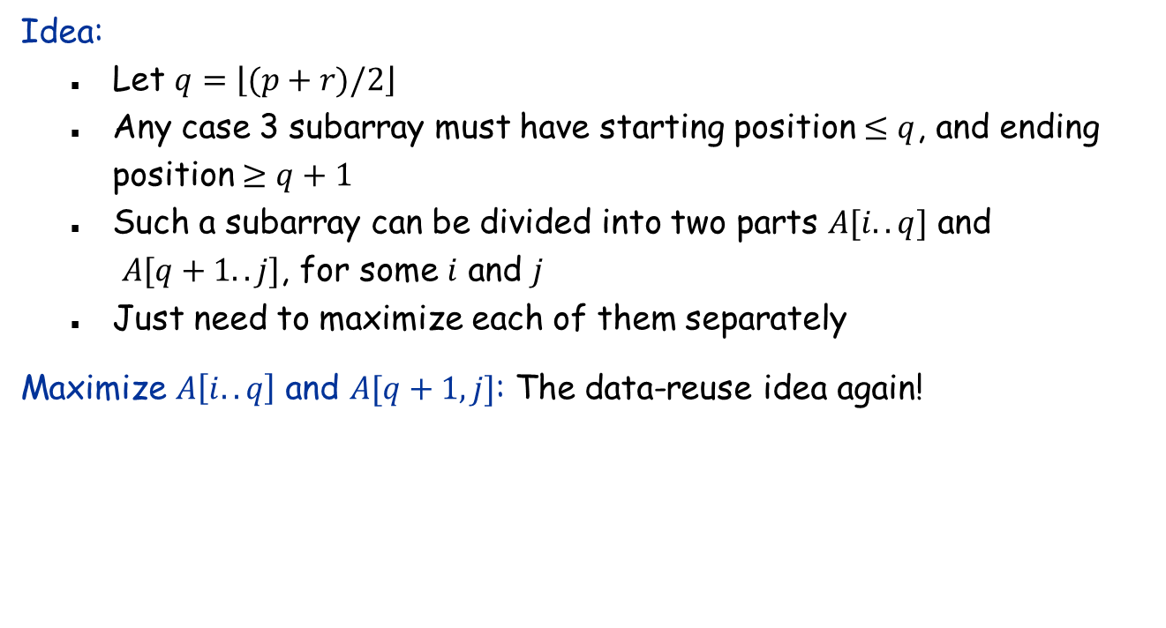
Solving case 3
Year | 1 | 2 | 3 | 4 | 5 | 6 | 7 | 8 | 9
Profit (M$) | -3 | 2 | 1 | -4 | 5 | 2 | -1 | 3 | -1
Idea:
Let $q=\left\lfloor (p+r)/2\right\rfloor$
Any case 3 subarray must have starting position $≤q$, and ending position $≥q+1$
Such a subarray can be divided into two parts $A[i..q]$ and $A[q+1..j]$, for some $i$ and $j$
Just need to maximize each of them separately
Maximize $A\left[i..q\right]$ and $A[q+1,j]$: The data-reuse idea again!

Slide 20
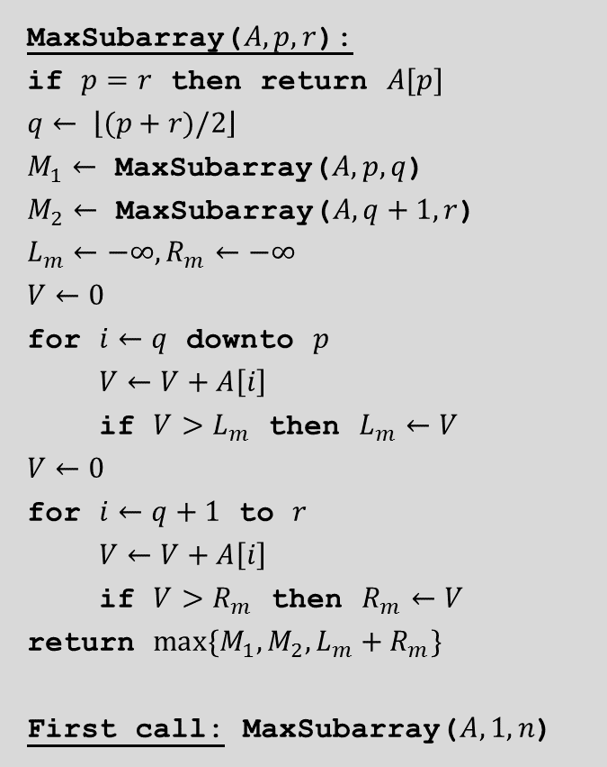
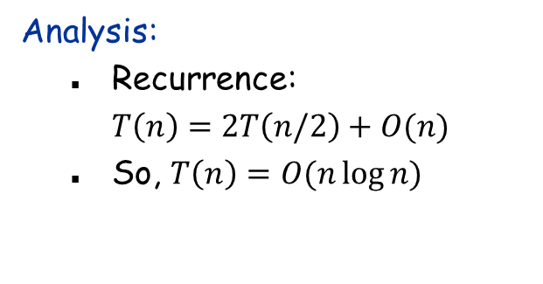
The complete divide-and-conquer algorithm
MaxSubarray($A, p, r$):
if $p=r$ then return $A[p]$
$$q← \left\lfloor (p+r)/2\right\rfloor$$
$M_{1}←$ MaxSubarray($A, p,q$)
$M_{2}←$ MaxSubarray($A, q+1, r$)
$$L_{m}←−∞,R_{m}←−∞$$
$$V←0$$
for $i←q$ downto $p$
$V←V+A\left[i\right]$
if $V>L_{m}$ then $L_{m}←V$
$$V←0$$
for $i←q+1$ to $r$
$V←V+A\left[i\right]$
if $V>R_{m}$ then $R_{m}←V$
return $max\{M_{1},M_{2},L_{m}+R_{m}\}$
First call: MaxSubarray($A, 1, n$)
Analysis:
Recurrence: $T\left(n\right)=2T\left(n/2\right)+O(n)$
So, $T\left(n\right)=O(n\log{n)}$

Slide 21
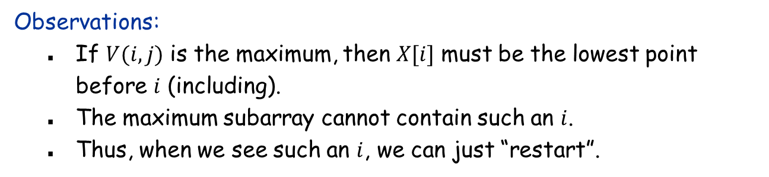
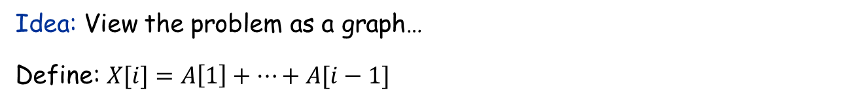
A linear-time algorithm?
Idea: View the problem as a graph…
Define: $X[i]=A\left[1\right]+…+A[i−1]$
Year | 1 | 2 | 3 | 4 | 5 | 6 | 7 | 8 | 9
Profit (M$) | -3 | 2 | 1 | -4 | 5 | 2 | -1 | 3 | -1
Observations:
If $V(i,j)$ is the maximum, then $X[i]$ must be the lowest point before $i$ (including).
The maximum subarray cannot contain such an $i$.
Thus, when we see such an $i$, we can just “restart”.

Slide 22
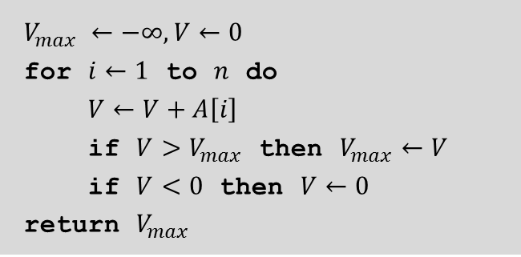
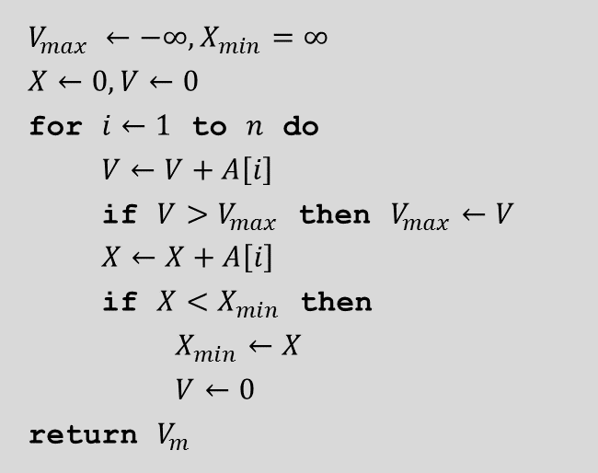

The linear-time algorithm
Even simpler:
$$V_{max} ←−∞,X_{min}=∞$$
$$X←0,V←0$$
for $i←1$ to $n$ do
$V←V+A\left[i\right]$
if $V>V_{max}$ then $V_{max}←V$
$X←X+A\left[i\right]$
if $X<X_{min}$ then
$X_{min}←X$
$V←0$
return $V_{m}$
$$V_{max} ←−∞,V←0$$
for $i←1$ to $n$ do
$V←V+A\left[i\right]$
if $V>V_{max}$ then $V_{max}←V$
if $V<0$ then $V←0$
return $V_{max}$
Observation:
${X<X}_{min}$ iff $V<0$
No need for $X$!

Slide 23



Another simple divide-and-conquer algorithm: Binary search
Input: An array $A$ of elements in sorted order, and an element $x$.
Output: Return the position of $x$ if it exists; otherwise output nil.
4
7
10
15
19
20
42
54
87
90
BinarySearch($A, p, r,x$):
if $p>r$ then return $nil$
$$q← \left\lfloor (p+r)/2\right\rfloor$$
if $A\left[q\right]=x$ return $q$
if $x<A\left[q\right]$ then BinarySearch($A,p,q−1,x$)
else BinarySearch($A,q+1,r,x$)
First call: BinarySearch($A,1,n,x$)
Recurrence: $T\left(n\right)=T\left(n/2\right)+1$, which solves to $T\left(n\right)=O(\log{n)}$.

